Slide 1

Simplification of Boolean Functions
Veitch-Karnaugh diagrams

Slide 2
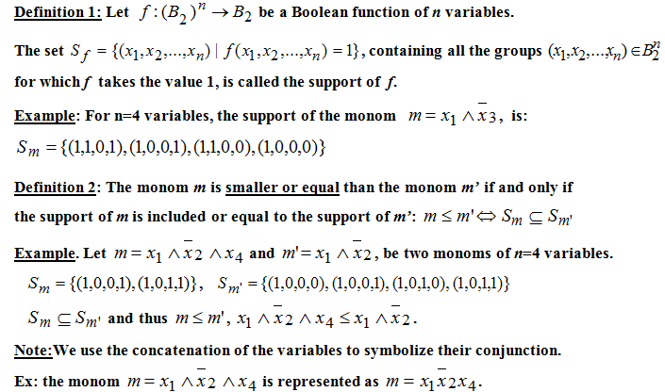
Definitions (I)

Slide 3
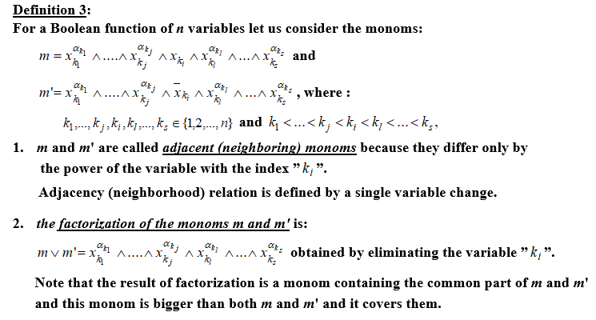
Definitions (II)

Slide 4
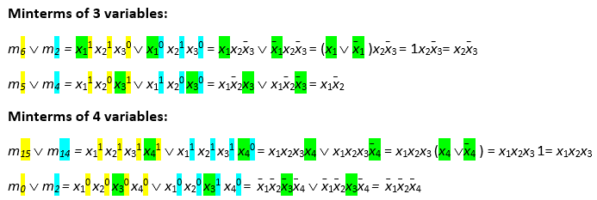
Factorization - examples

Slide 5
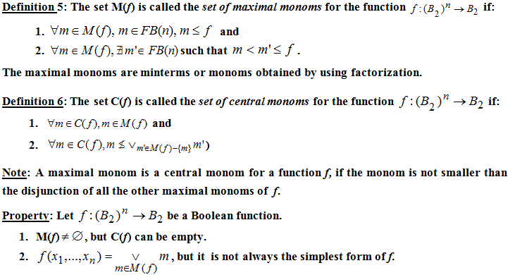
Definitions (III)

Slide 6
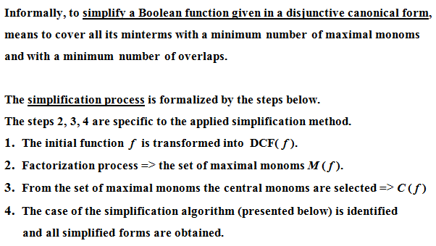
Simplification of Boolean Functions

Slide 7
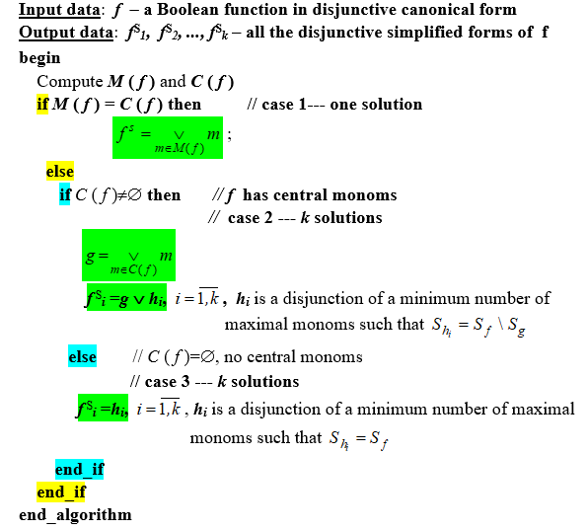
Simplification Algorithm

Slide 8

Simplification Methods

Slide 9




Veitch-Karnaugh Diagrams Method

Slide 10
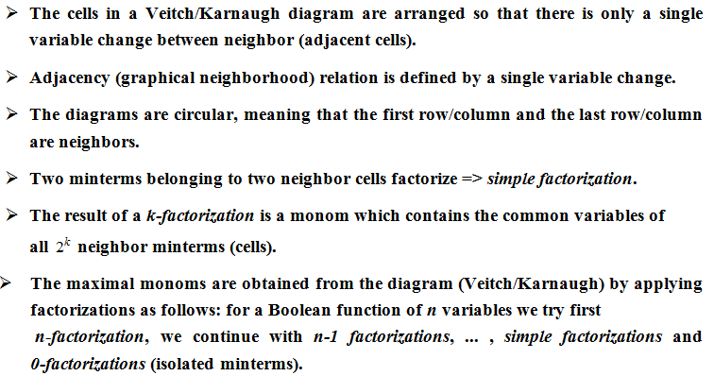
Veitch-Karnaugh Diagrams Method

Slide 11
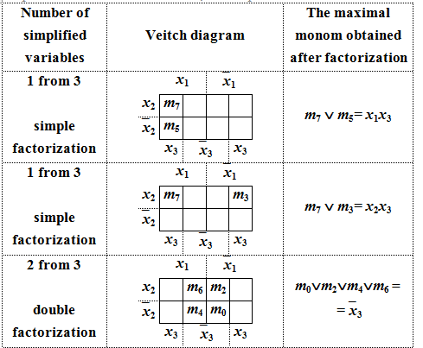
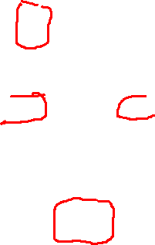
Examples of factorizations (I)

Slide 12
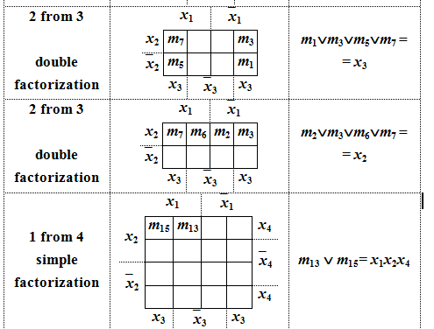

Examples of factorizations (II)

Slide 13

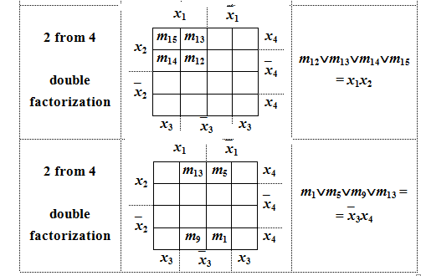
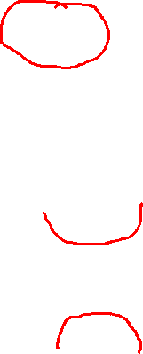
Examples of factorizations (III)

Slide 14

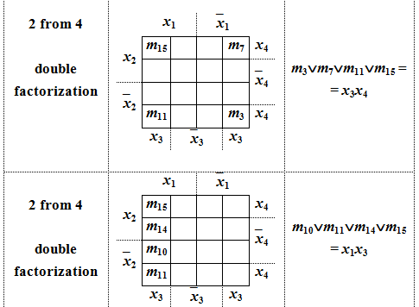
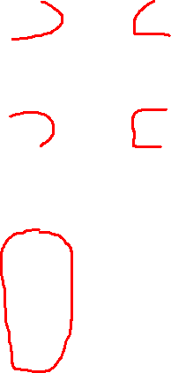
Examples of factorizations (IV)

Slide 15
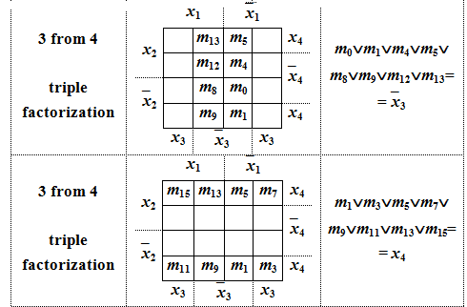
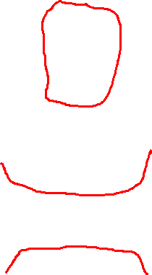
Examples of factorizations (V)

Slide 16
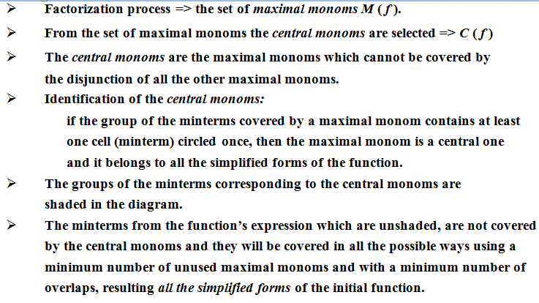
Veitch-Karnaugh Diagrams Method

Slide 17
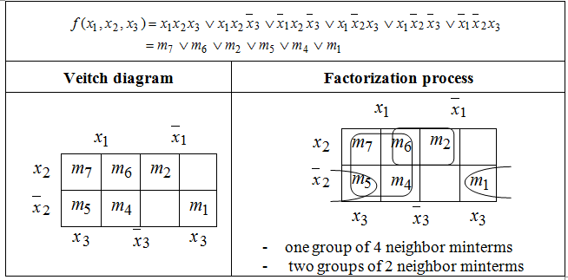
Example 1. simplify the Boolean function:

Slide 18
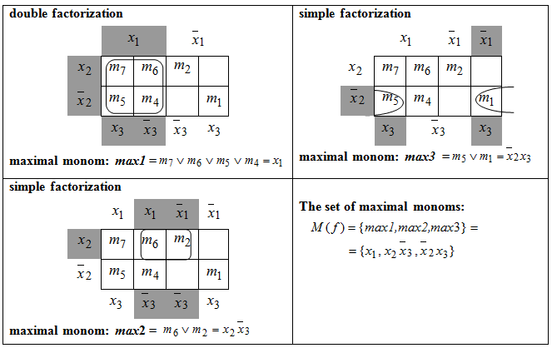
Example 1 – Factorization process

Slide 19
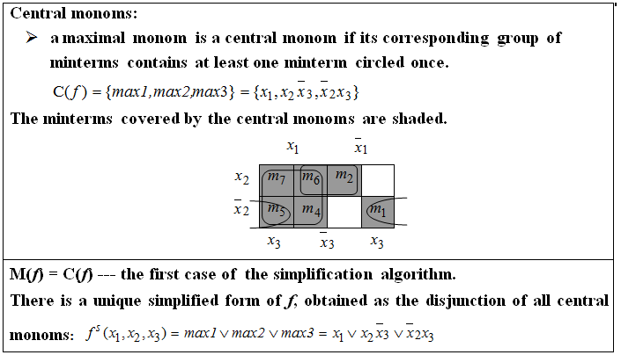
Example 1(contd.)

Slide 20


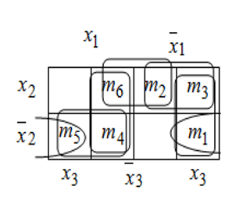
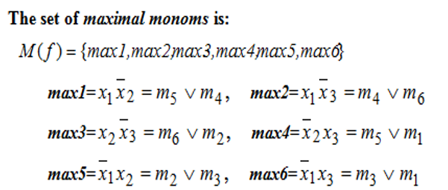

Example 2. simplify the Boolean function:
Representation using Veitch diagram:

Slide 21

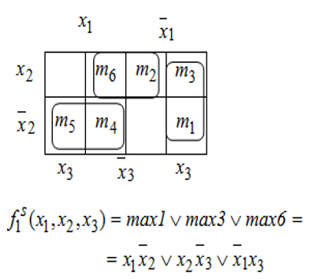
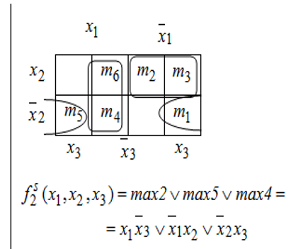
Example 2- Simplified forms

Slide 22
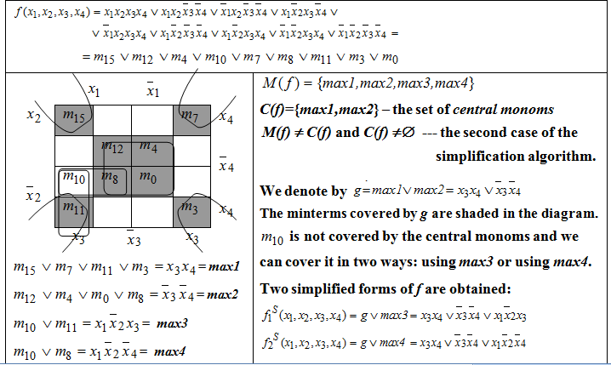
Example 3. simplify the Boolean function

Slide 23

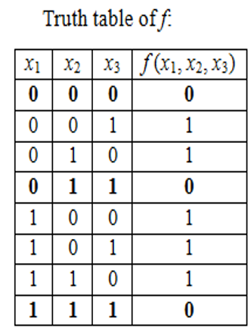


Example 4. simplify the Boolean function

Slide 24
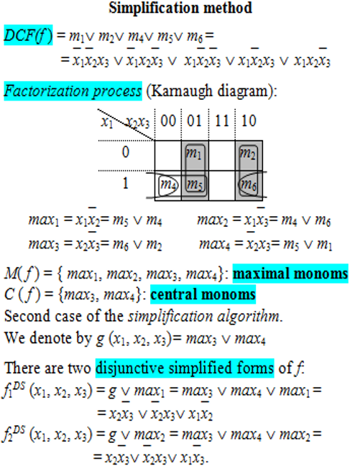
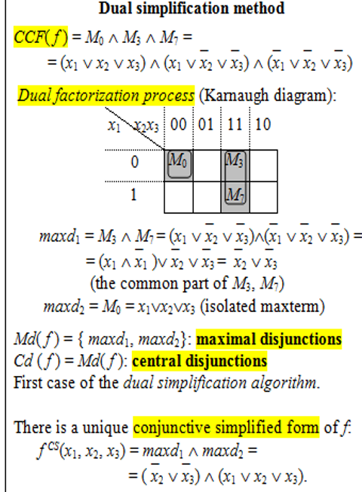
Example 4 (contd.)

Slide 25
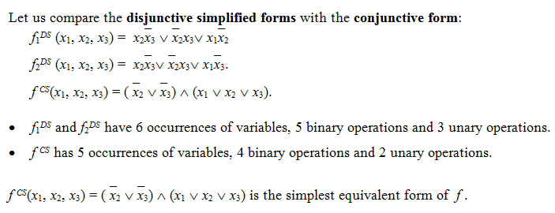
Example 4 (contd.)

